Slide 1
L6: Diffraction I
Nami Matsubara
KTH Royal Institute of Technology
namim@kth.se

Slide 2
Outline
Neutrons vs x-rays
Instrumentation
Powder and single crystal diffraction
The Rietveld method
Total scattering
Magnetic diffraction
Notes:
I think you all downroad Fullprof.

Slide 3
6 Blind men and the elephant
Neutron
Electron
Modeling
Raman
X-ray
FTIR
Notes:
It is a story of a group of blind men, who have never meet with an elephant before and who learn what the elephant is like by touching it. Each blind man feels a different part of the elephant's body, but only one part. They then describe the elephant based on their limited experience and their descriptions of the elephant are different from each other.
We can apply same story to the material science,
In our case, elephant is c onsidered material. Each blind men could be each technique. They all have different eyes thus it is very important to combine together to understand your material deeply.

Slide 4
Different eyes: X-ray vs Neutron
Carbon atom C⁶
6 Electrons
6 Neutrons + 6 Protons
Notes:
Here is a carbon atom, and comprises of nucleas and electrons

Slide 5
Different eyes: X-ray vs Neutron
Carbon atom C⁶
X-ray
X-ray has interactions with the electrons.
X-rays are scattered by electron cloud of atoms.
Form factor of X-ray has atomic number dependence.
Small penetration depth
Surface studies
X-ray
6Electrons
6 Neutrons + 6 Protons
Notes:
X-ray has interaction with these electrons,
The scattered wave from an atom is proportional to the atomic number.

Slide 6
Different eyes: X-ray vs Neutron
Carbon atom C⁶
Neutron (Structure )
Neutrons are uncharged and has interactions with the the nuclei.
Neutrons are scattered by nuclei (point).
Scattering length of neutron is random.
Deep penetration depth
Large volume of sample
Bulk studies of samples
Neutron
6 Electrons
6Neutron + 6Proton
Notes:
On the other hand neutron has intraction with nucles.

Slide 7
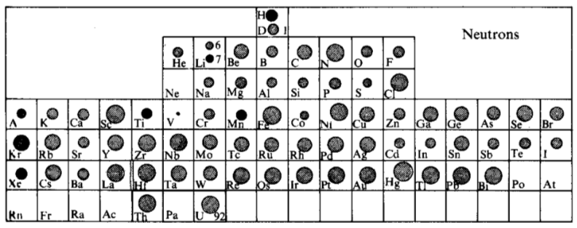
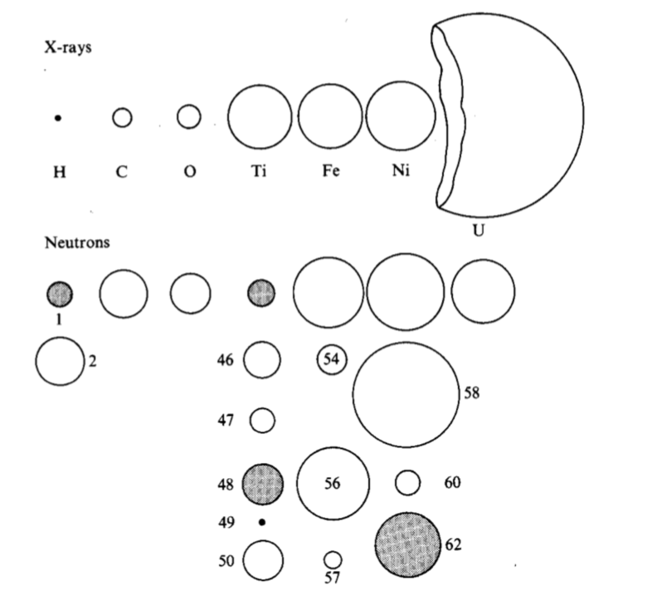
Scattering length
Periodic table with scattering length
Light atoms
Different contrast with X-ray
Isotope dependence
Isotope dependence
Bacon, Neutron diffraction
Notes:
The radii of the circles are propoftional to scattering length.
The variation of scattering amplitude is in general a slight increase with Z number.
But it is still considered as irregular.
As you can see, most atoms scatter neutrons also equally well, in contrast to the rapid increase with atomic number of the X-ray scattering amplitude.
Unlikely X-ray, it also has isotope dependence. For example, hydrogen and ditulium,

Slide 8
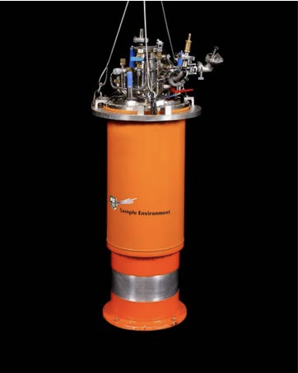
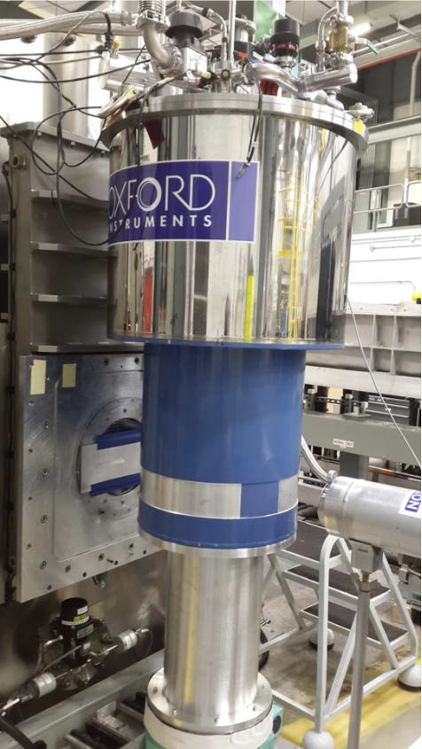
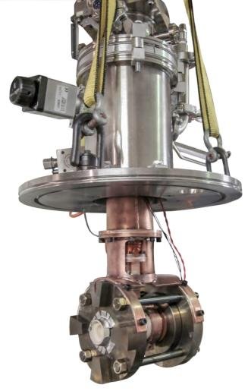
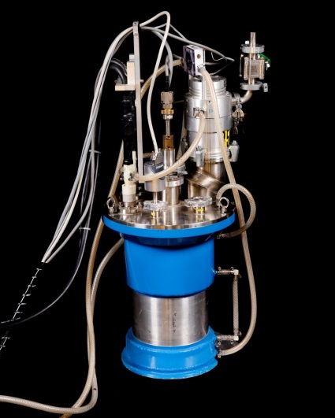
High penetration
Many different sample environments!
Low temperature
High temperature
High pressure
Magnetic field
Notes:
Due tot the high penetration depth, we can actually set up various sample enviroment for neutron experimment.

Slide 9
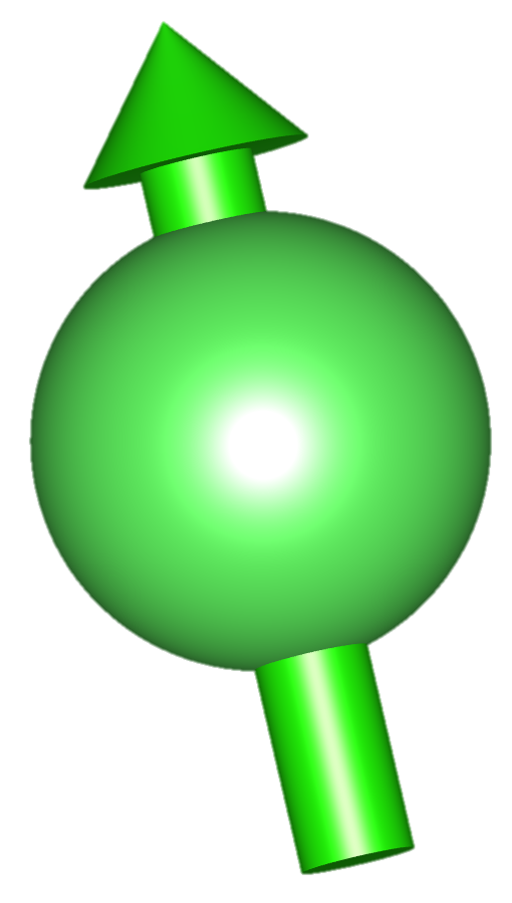
Different eyes: X-ray vs Neutron
Neutron (Spin)
N
Neutron
Neutrons are uncharged but do have a magnetic moment (Spin 1/2).
An additional scattering due to the dipole-dipole interaction between the nuclear spin of neutron and the unpaired electrons (outer shell).
Notes:
The nuclear spin of the neutron undergoes a dipole dipole interaction with the unparied electrons in the magnetic material.
Thus when the spins are ordered, magnetic Bragg peaks will emarge.

Slide 10
Form factor
X-ray
Neutrons
Neutrons
F(Q)
F(Q)
F(Q)
Nuclear
Spin
X-ray
Q
Q
Q
Notes:
As the angle between the incident and scattered directions increases, this amplitude will fall off quite rapidly
On the other hand, neutron shows no variation with the angle theta. This different comes from the fact that the dimensions of the electronic cloud are comparable with the wavelength of the X-rays whereas neutron scatters by point.

Slide 11
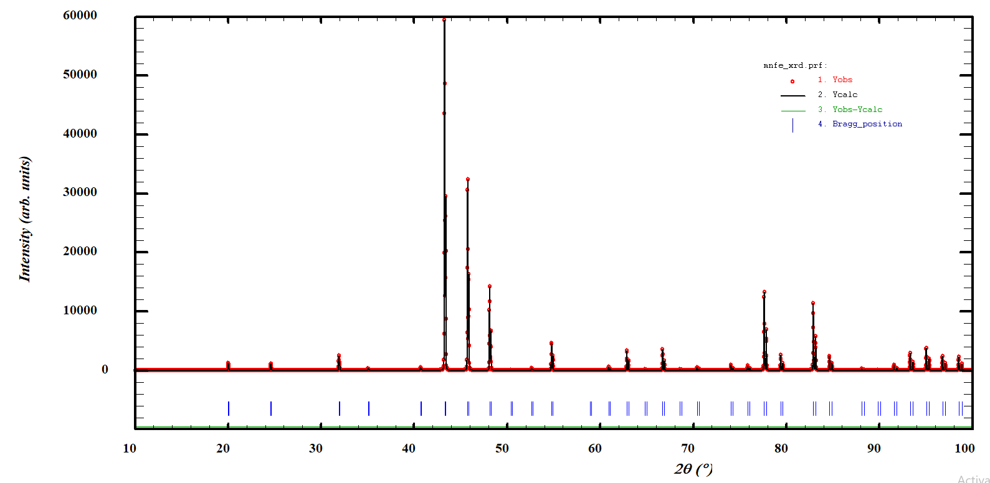
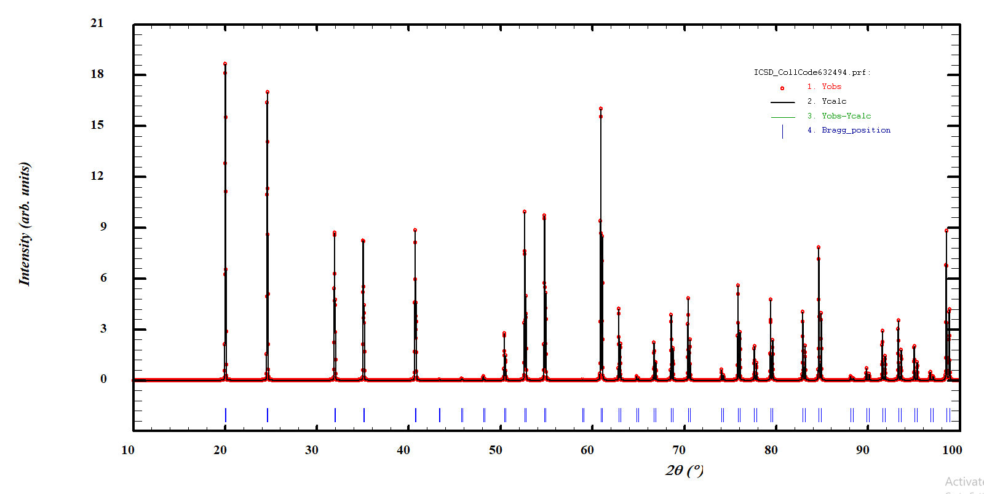
How different?: Example:Mn_{0.3}Fe_{0.7}
Mn_{0.3}Fe_{0.7}
Simulated pattern
X-ray
 | Fe | Mn
Neutron | 9.45 | -3.73
X-ray (Z- number) | 26 | 25
More information at high-Q
The profile is simpler
The different scattering contrast among the elements
Neutron

Slide 12
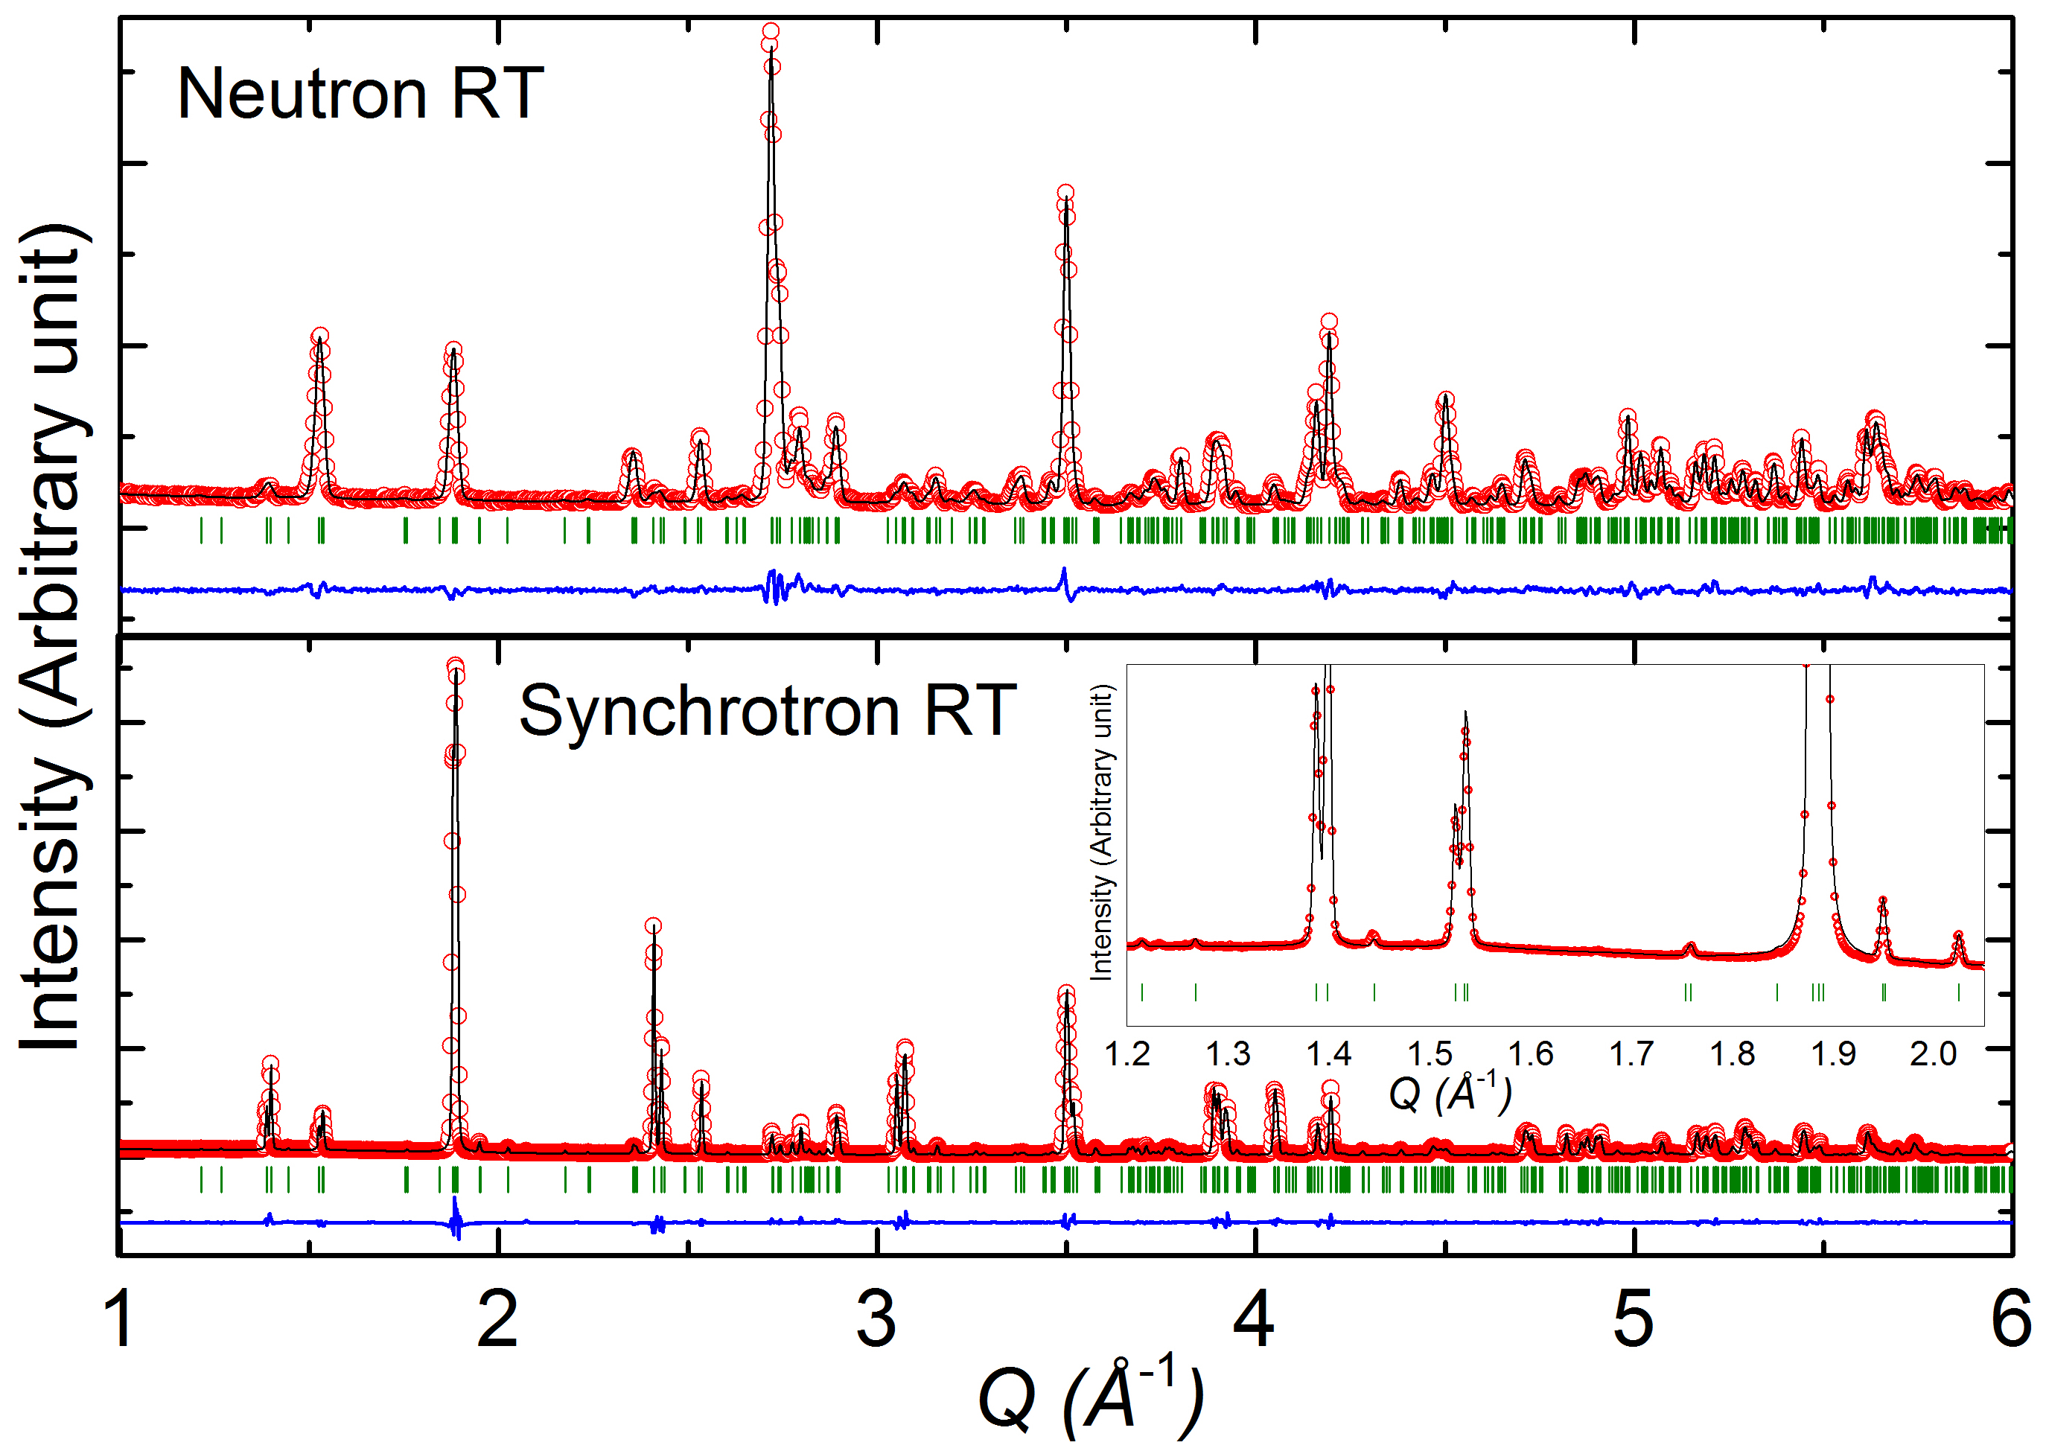
How different?: Example:BiMnTeO₆
BiMnTeO₆
D2B, ILL
 | Bi | Mn | Te | O
Neutron | 8.532 | -3.73 | 5.8 | 5.8
X-ray (Z- number) | 83 | 25 | 52 | 6
More information at high-Q
The profile is simpler
The different scattering contrast among the elements
BL04, ALBA
Notes:
- the weight of the different atoms is more equilibrated
-determination of the structural parameters possible

Slide 13
Neutron vs X-ray: Practical
X-ray
  Daily used to provide structural information on compounds, identify samples and check the quality of sample
  Both powder and single crystal, Both inhouse and synchrotron
Neutron diffraction
  Combining with X-ray, it is good complimentary techniques to determine crystal structure
  Also possible to see magnetic ordering
  Need to be performed at large scale facilities
  Required large volume of samples (powder and single crystal)
Notes:
Non destructive

Slide 14
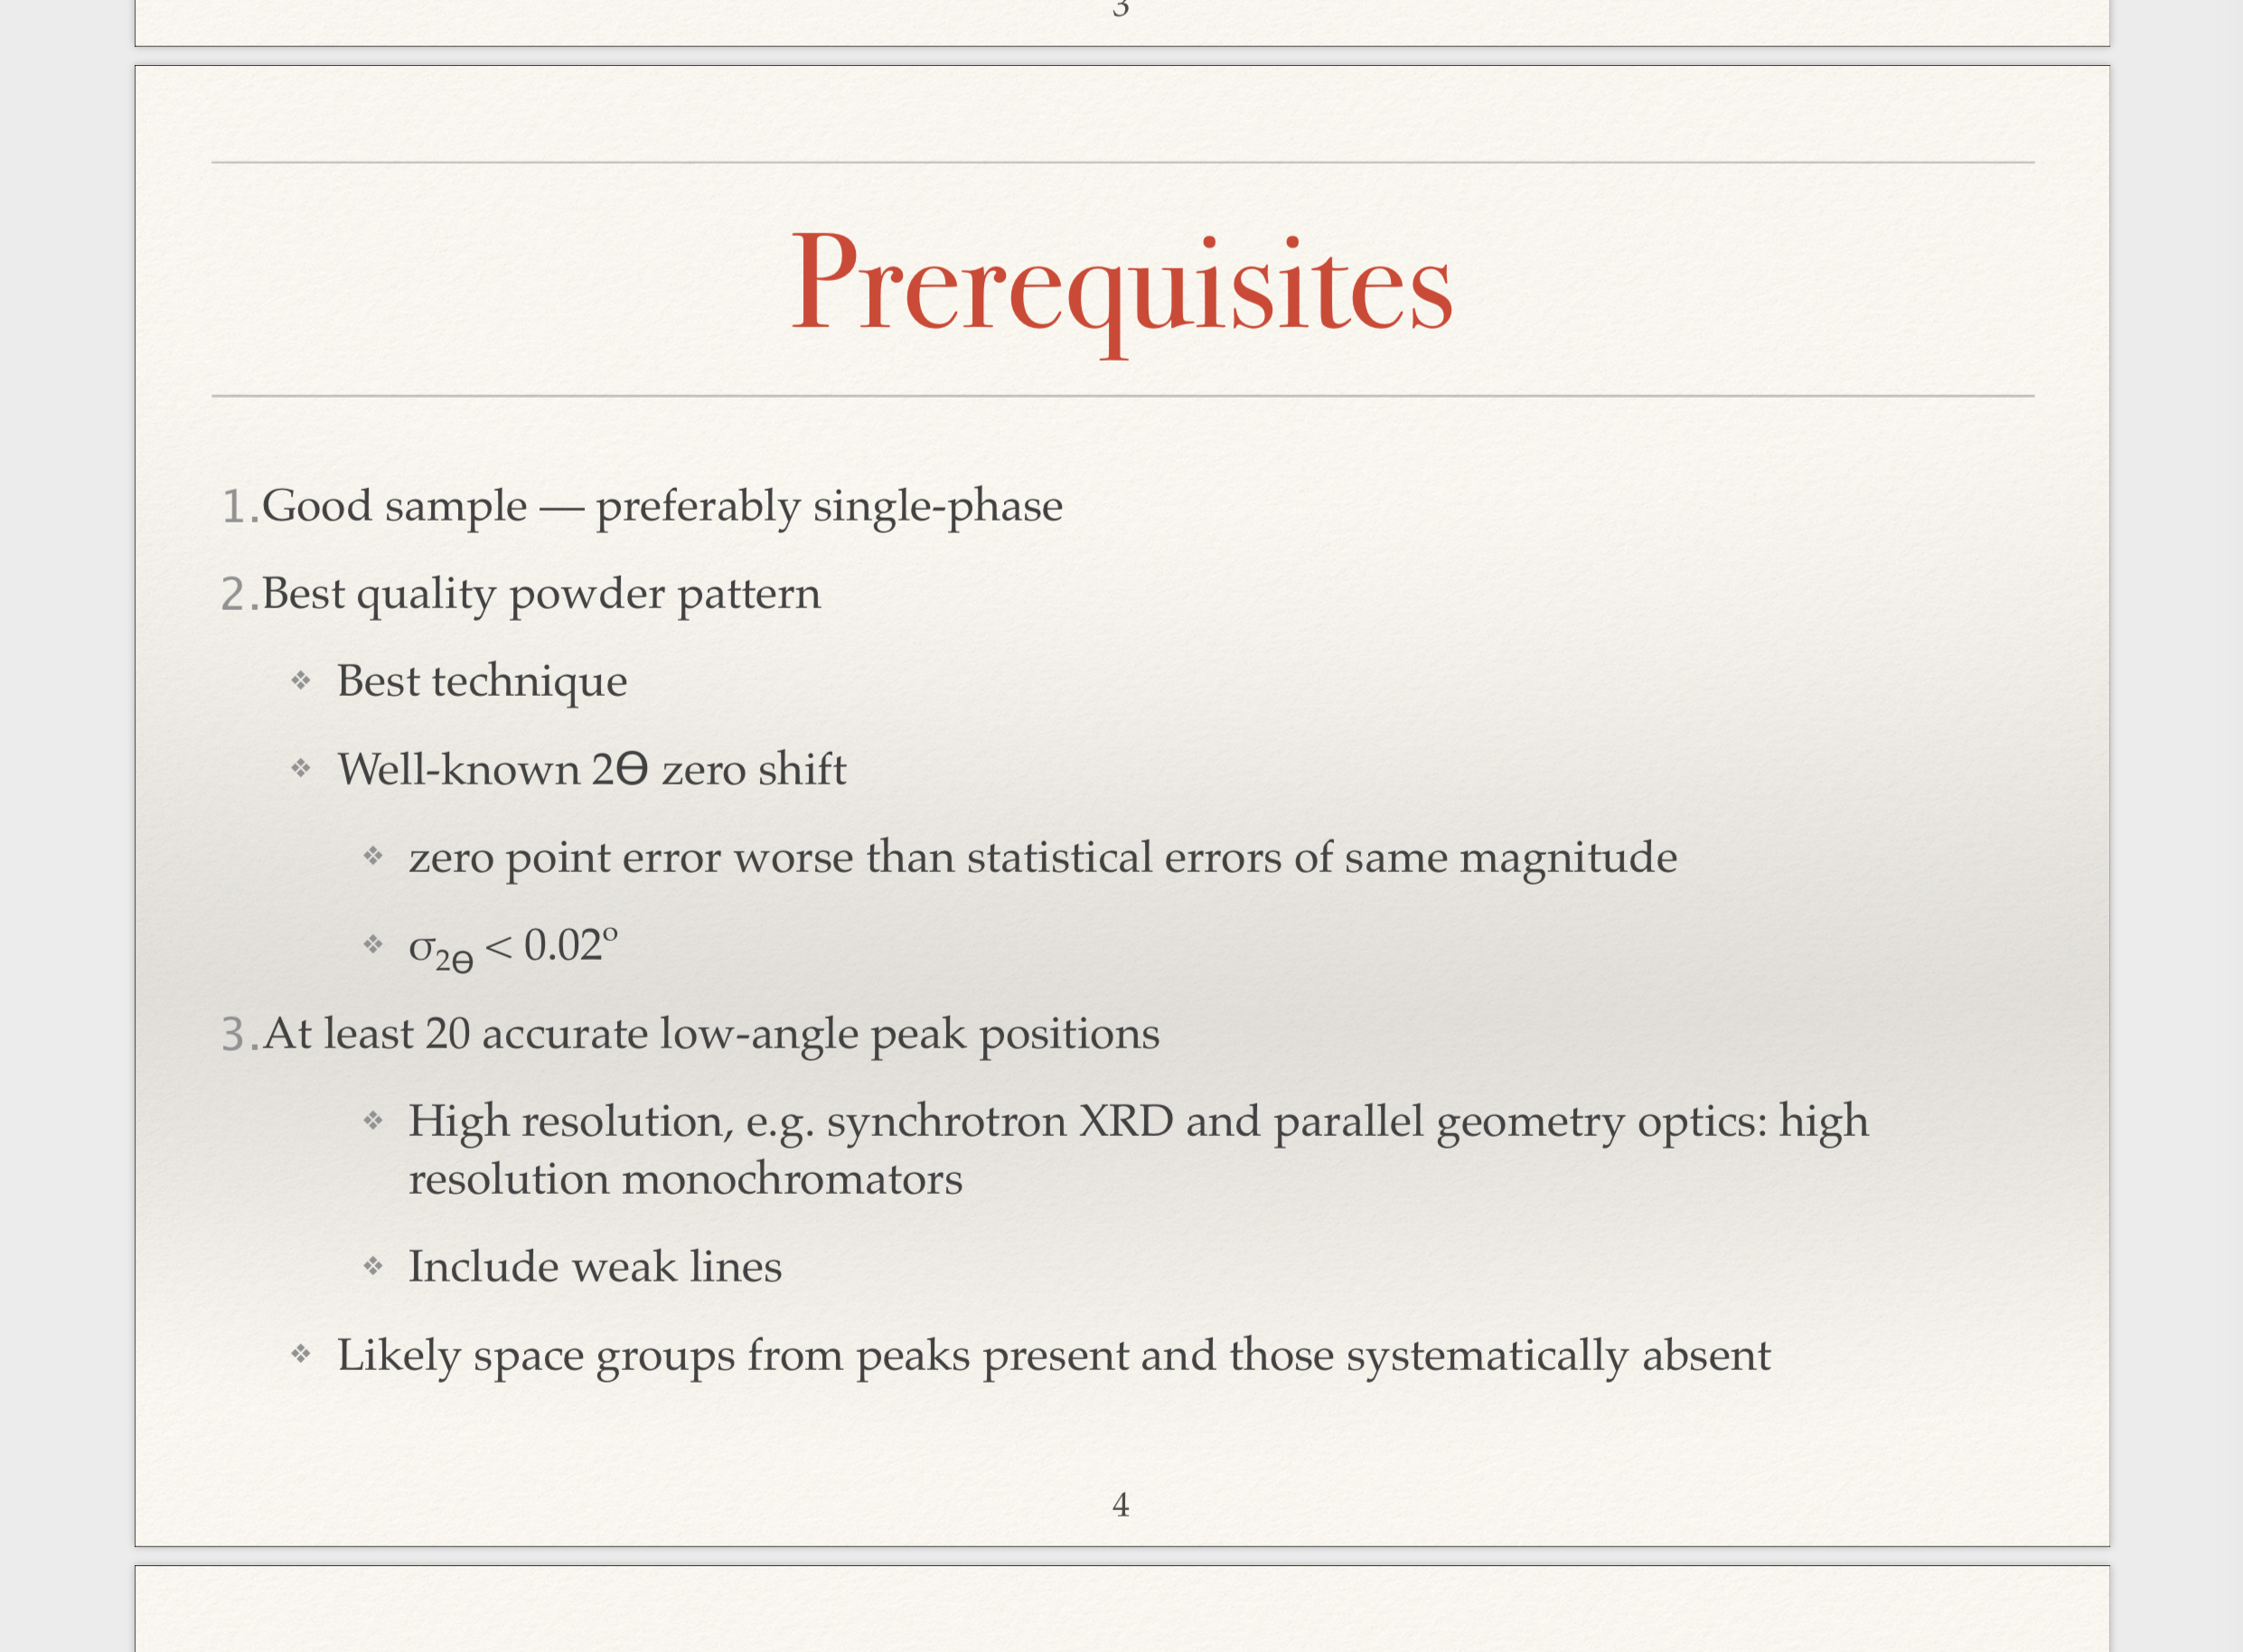
Before… Writing the proposal
Good sample – single phase, good crystallinity
Basic characterization
  XRD in the laboratory
  Crystal structure
  Chemical compositions
  Physical properties
Choose best techniques and beamline
  What do you want to know from the diffractions????
Notes:
Indexing_powder_diffraction_data_TCH.pdf

Slide 15
Current sources
Main reactors in Europe
ILL – Grenoble
FRM II – Munich
Orphee-LLB – Saclay (end ~ 2020)
BERII-HZB (end ~ 2020)
BNC – Budapest
IRI – Delft
Gatchina – Russia
NPL – Prague
Spallation sources in the world
SNS – Oakridge
J-PARK – Japan
C-SNS – China
ISIS – Oxford
LANSCE – USA
SINQ-PSI – Switzerland
ESS – Lund

Slide 16
Neutron source
Reactor : Continues
  High energy is rather difficult
  High average flux
Spallation: Pulsed
  High energy is good but low energy is difficult
  Very high flux in pulse, but rather low average flux
  Diffraction: T.O.F method
https://europeanspallationsource.se

Slide 17
Constant wavelength v.s. TOF
Constant wavelength
  Higher Flux
  Monochomater (resolution)
ILL
D1A, D1B, D2B, D9, D10, D19, D20, …
LLB
3T2, G4.1, G4.2, 5C1, 5C2, 6T2 …
FRMII
SPODI, BIODIFF, RESI, HEiDi …
Time of Flight
  Wide Q-range (many detector banks)
  Pulse-source (Moderator)
ISIS
GEM, WISH, POLARIS, HRPD, HiPr, SXD …
SNS
POWGEN, SINGLE CRYSTAL, POWDER, SNAP, TOPAZ …
J-PARC
iMATERIA, SPICA, superHRPD, iBIX, SENJU
ESS
  DREAM, MAGiC
Single crystal
Notes:
https://slideplayer.com/slide/12965639/

Slide 18
Different techniques
DIffraction
Neutron
Spallation source
T.O.F
Continuous source
X-ray
Monochromatic beam
Laue

Slide 19
Different techniques
DIffraction
Neutron
Spallation source
T.O.F
Continuous source
X-ray
Monochromatic beam
Laue

Slide 20
Different techniques
DIffraction
Neutron
Spallation source
T.O.F
Continuous source
X-ray
Monochromatic beam
Laue

Slide 21
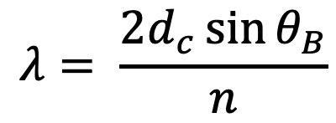
Determination of wavelength
Crystal monochromator (Bragg diffraction)
φ
Detector
Sample
Source
θ_{Β}
Monochromator
(e.g. Si, Ge , Cu, Graphite..)
https://www.mlz-garching.de/englisch/neutron-research/neutron-source.html
$$λ= \frac{{2d}_{c}\sin{θ_{B}}}{n}$$
Notes:
https://slideplayer.com/slide/2401938/

Slide 22
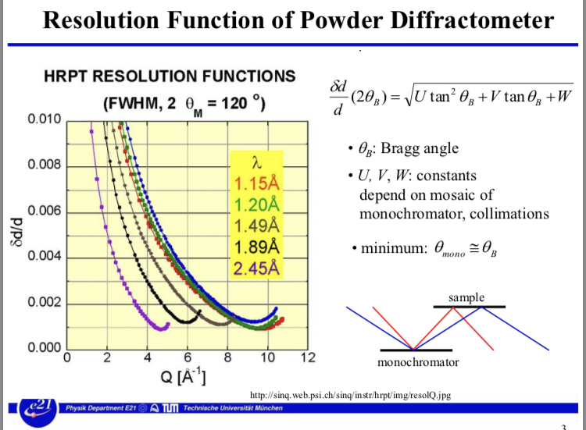
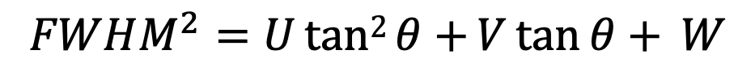
Dependence of the resolution on 2θ
$$FWHM^{2}=Utan2{θ+}V\tan{θ+} W$$
Why important?
* V could be negative.
Neutrons
There is a minimal FWHM near the angle of the monochromator-take-off.
F(Q)
Nuclear
F(x)
FWHM
F_{max}
Spin
F_{max}/2
Q
0
θ₁
θ₂

Slide 23
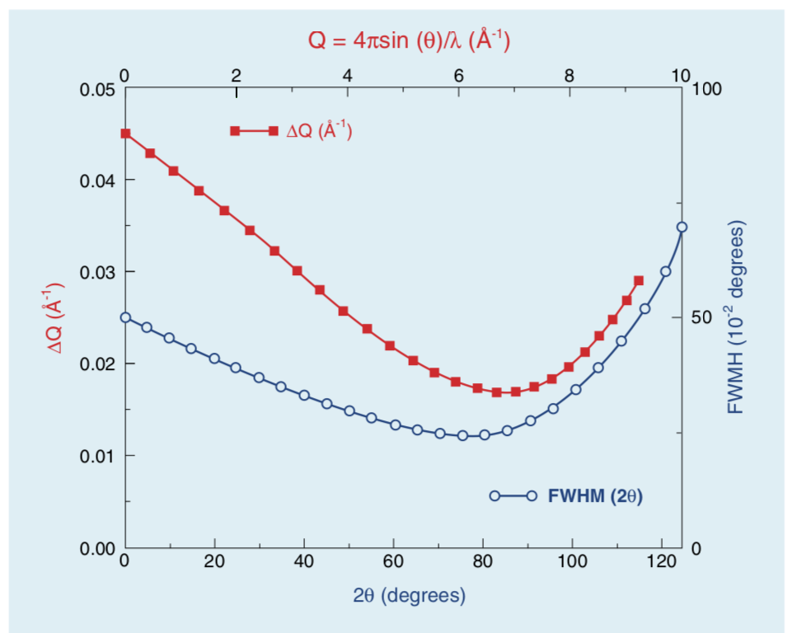
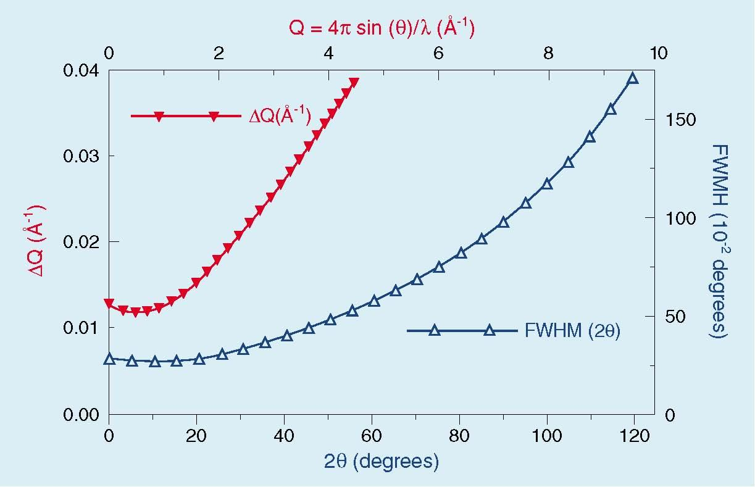
Different resolution depending on the beamline
G.4.1 (LLB) λ = 2.45 Å
3T2 (LLB) λ = 1.25 Å
Magnetic structure !!
Crystal structure !!
http://www-llb.cea.fr/

Slide 24
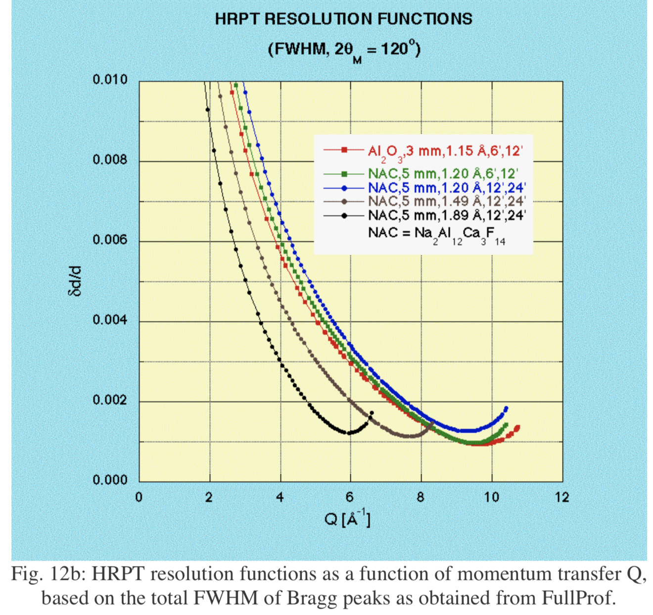
Different resolution depending on the wavelength
User guide HRPT

Slide 25
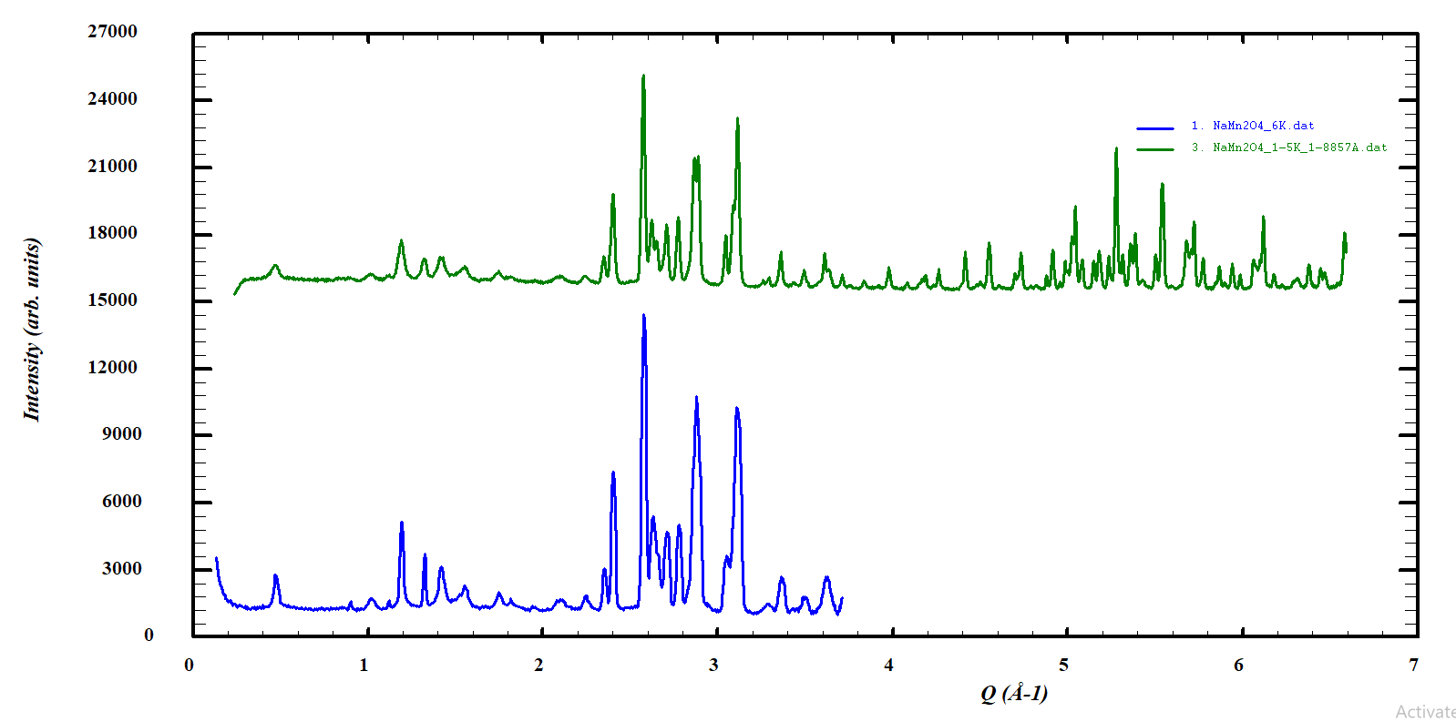
Different resolution depending on the beamline
HRPT (PSI)
λ = 1.88 Å
DMC (PSI)
λ = 2.45 Å

Slide 26
Different techniques
DIffraction
Neutron
Spallation source
T.O.F
Continuous source
X-ray
Monochromatic beam
Laue

Slide 27
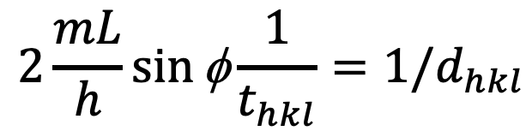
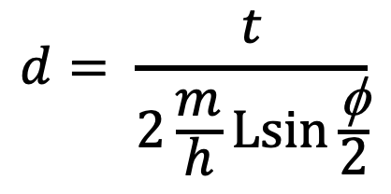
T.O.F diffraction
T.O.F diffraction (angle-dispersive):
use a white beam (neutrons with different wavelengths travel at different speeds)
Instead of varying the scattering angle (fixed angle φ),measuring their flight time t over a distance L in order to determine velocity of neutrons (wavelength)
the time-of-flight of neutrons when pulsed beams are applied.
t = 0 is naturally signaled by the start of the pulse.
$$2\frac{mL}{h}\sin{\text{f}}\frac{1}{t_{hkl}}={1/d}_{hkl}$$
Detector
Pulsed source
L₂
$$d= \frac{t}{2\frac{m}{h}\operatorname{Lsin}{\frac{\text{f}}{2}}}$$
L₁
φ
m: Mass of neutron
h: Plank constant
L: Total flying distance (L1+L2)
Sample

Slide 28
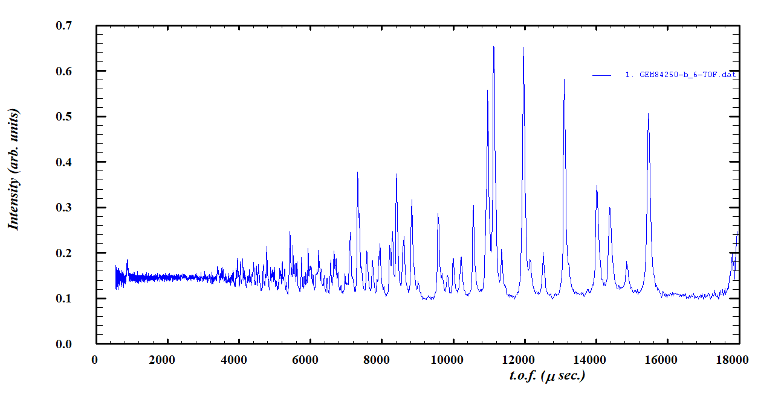
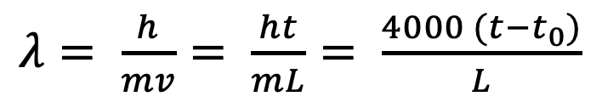
T.O.F diffraction
Cover wide Q-range by different bank detectors.
  Possible to refine crystal and magnetic structure at same time
Data volume is usually huge.
  Requires to combine diffractogram from different bank.
Detector
Pulsed source
L₂
L₁
φ
Sample
$λ= \frac{h}{mv}= \frac{ht}{mL}= \frac{4000 (t−t_{0})}{L}$
m: Mass of neutron
h: Plank constant
L: Total flying distance (L1+L2)
Notes:
So here basically no geometrical restriction due to the moving detector, principally you can measure up to infinity Q range by turning initiial velocity by modulater and covering the whole range by detector.
This is the biggest advantage,

Slide 29
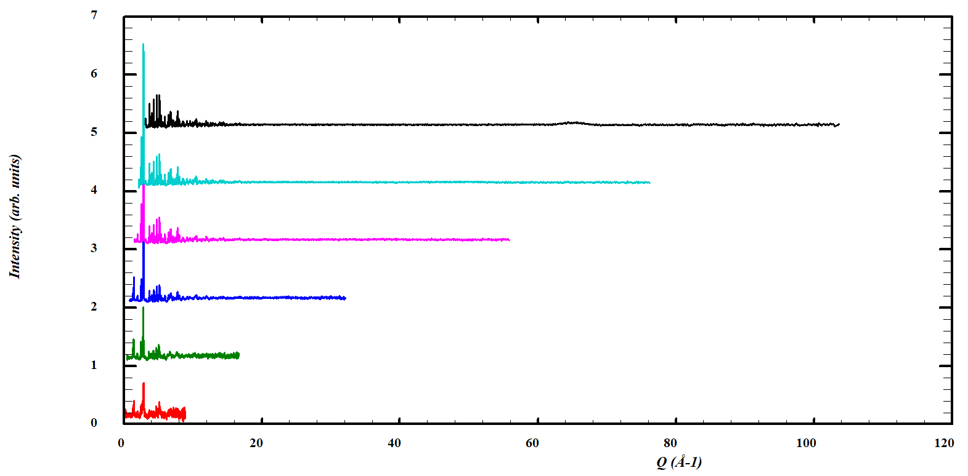
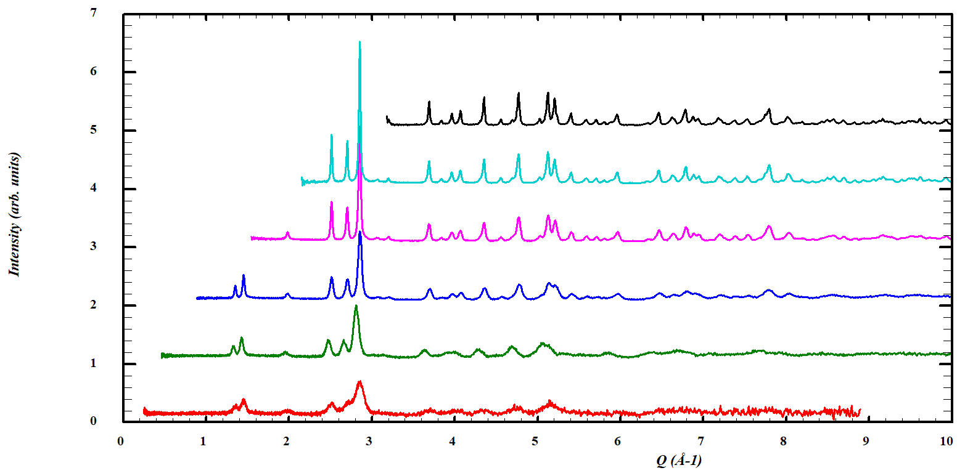
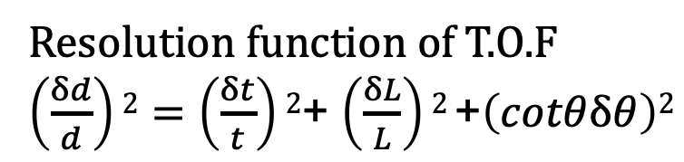
T.O.F powder diffraction (Spallation)
Example: GEM data
Resolution function of T.O.F
$\left(\frac{δd}{d}\right)2=\left(\frac{δt}{t}\right)2$+ $\left(\frac{δL}{L}\right)2$+$\left(cotθδθ\right)2$
Back scattering Bank 6
90° Bank 5
Bank 4
Bank 3
Bank 2
Low angle Bank 1

Slide 30
Different techniques
DIffraction
Neutron
Spallation source
T.O.F
Continuous source
X-ray
Monochromatic beam
Laue
Single crystal
Powder diffraction
Single crystal
Powder diffraction

Slide 31
Materials
Single crystal
Bi metal
Bi metal
Powder
~cm
~nm

Slide 32
Classification of Techniques
Single crystal diffraction
  One large crystallite
  Diffraction condition is met at points in 3D reciprocal space.
  Appropriate for larger molecules and unit cells
Powder diffraction
  Many small crystallites are randomly oriented.
  Diffraction condition is met at points in 3D reciprocal space.
  Measure in one direction
Powder
Polycrystal
Monochromatic beam
Variable Angle
Varied by different grains (orientations)

Slide 33
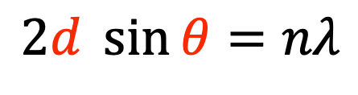
Diffraction pattern
$$2d \sin{θ}=nλ$$
Single crystal diffraction pattern
Powder diffraction pattern
In reciprocal space
In reciprocal space
a
Notes:
Constructure

Slide 34
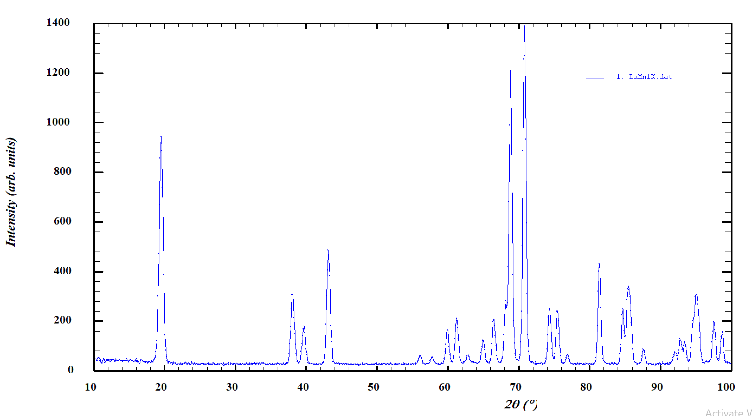
Diffraction pattern
$$2d \sin{θ}=nλ$$
Single crystal diffraction pattern
Powder diffraction pattern
In reciprocal space
In reciprocal space
a
Notes:
Constructure

Slide 35
Diffraction patterns
Laue spots
Debye Scherrer rings
Diffraction gives the reciprocal point lattice in single crystal
Using powder, the rotation averaging leads to smooth diffraction rings
Position of spots or lines follow to Bragg equation

Slide 36
Laue vs Single crystal diffraction
Single crystal diffraction (Rotation method)
  Monochromatic radiation hits a sample as it is rotated and manipulated to bring different planes into diffraction condition.
  Single crystal diffractometer either 3- or 4- circle goniometers.
  The sample rotates along an axis φ
  In order to cover all the diffraction spots in 3D, the goniometer must rotate along axes Ω and χ

Slide 37
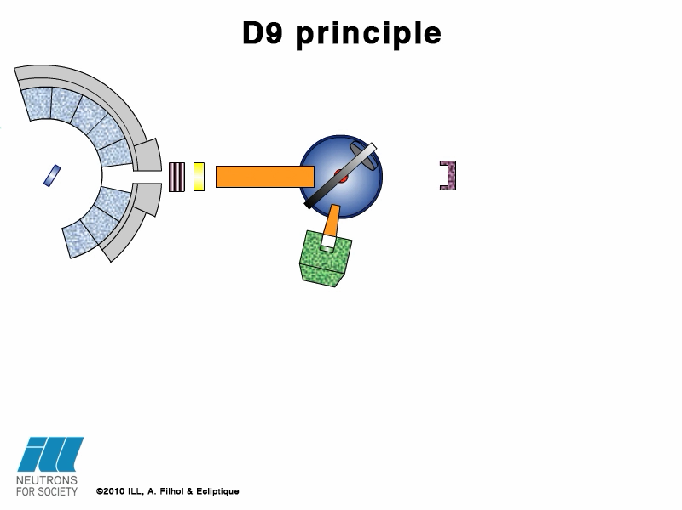
Example: D9
ILL webpage

Slide 38
Laue vs Single crystal diffraction
Laue method
  The Laue method is mainly used to determine the orientation of large single crystals.
  The Bragg angle is fixed.
  Each set of planes picks out and diffracts the particular wavelength from the white radiation that satisfies the Bragg law for the values of d and θ involved.
The Laue method is mainly used to determine the crystal orientation.
  Preparation for the single crystal experiment
  Sample quality check (single? or poly?)
  Required lattice parameters information
  Neutron Laue is useful if you want to align many crystals
  for neutron experiment!
Notes:
The radiation is reflected from , or transmitted through a fixed crystal. The diffracted beams form arrays of spots, that lie on curves on the film.

Slide 39
Example: OrientExpress
ILL webpage

Slide 40
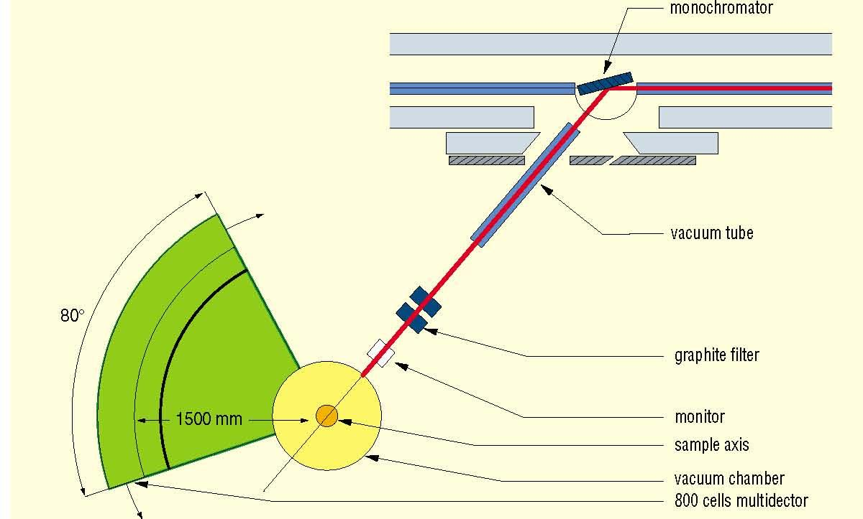
Powder Diffraction: Constant wavelength
Powder diffraction
  A technique used to characterize the crystallographic structure, crystallite (grain) size, preferred orientation in polycrystalline or powdered solid samples.
http://www-llb.cea.fr/

Slide 41
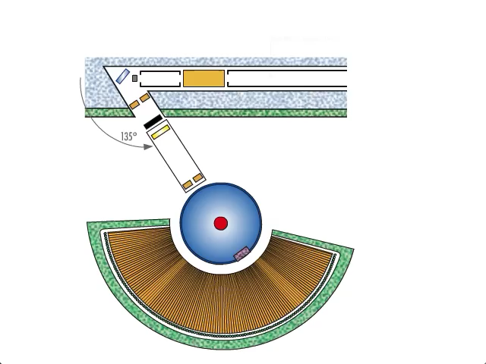
Example:D2B
ILL webpage
Notes:
The polychromatic beam from the thermal guide H22 is diffracted by the monochromators with a take-off angle of 44.22º towards the sample positions which is 3000mm downbeam.
The sample, a polycrystalline powder, loaded inside a cylinder vanadium can, diffracts the monochromatic incident beam.
The Bragg reflections are mesured by a multi-detector with 1280 cells with a separation of 0.1º, covering the angular range 0.8 to 128.8º. A whole diffraction pattern is thus collected while the detector remains steady.
Note the Radial Oscillating Collimator (ROC) which eliminates the parasitic diffraction beams from sample environment devices.
The recorded neutron diffraction patterns (bottom-left inset) make it possible to study the structure of matter and phase transitions.

Slide 42
Powder diffraction and the Rietveld refinement

Slide 43
Before… neutron diffraction!
Good sample – single phase, good crystallinity
  Necessary for structural analysis (complex or novel phases)
Basic characterization
  XRD in the laboratory
  Crystal structure
  Chemical compositions
  Physical properties
Pattern Simulation (very different from XRD one)
Write beamtime proposal (select correct source + instrument)s
Notes:
Indexing_powder_diffraction_data_TCH.pdf

Slide 44
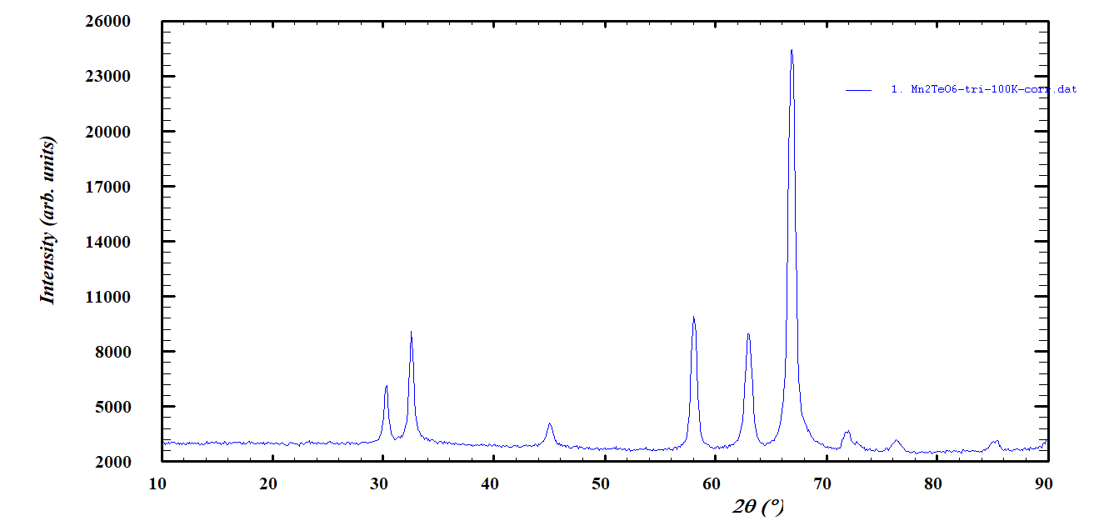
Experiment

Slide 45


Software list (just a part)
FullProf (ILL, Juan Rodriguez-Carvajal)
Jana2006 (Institute of Physics, Praha, Vaclav Petricek)
GSAS (US, Robert Von Dreele, Brian Toby)
Rietan (NIMS,Japan, Fujio Izumi)
Z-Reitveld (KEK, Japan)
TOPAS (BRUKER)
X’Pert highscore (Panalytical)

Slide 46
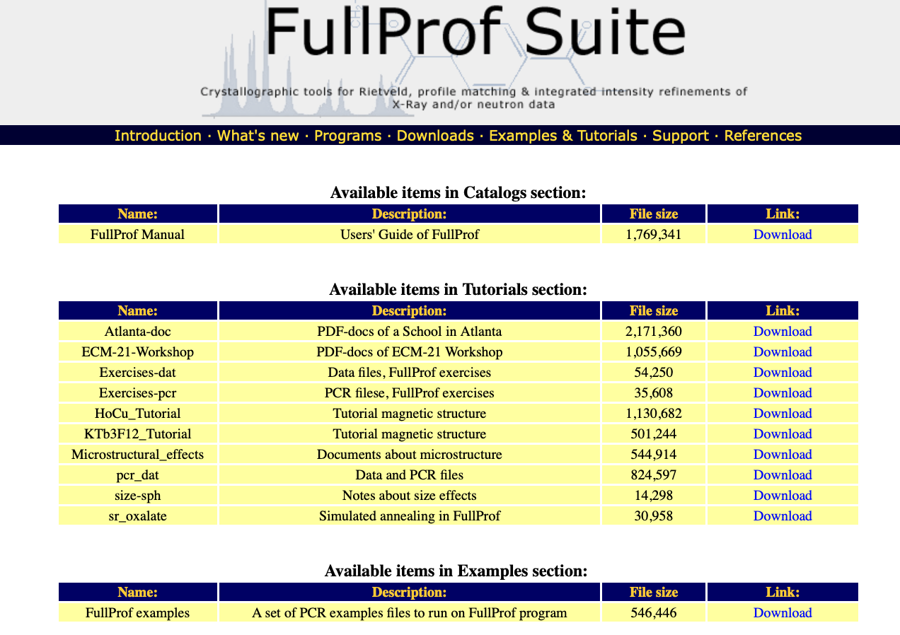


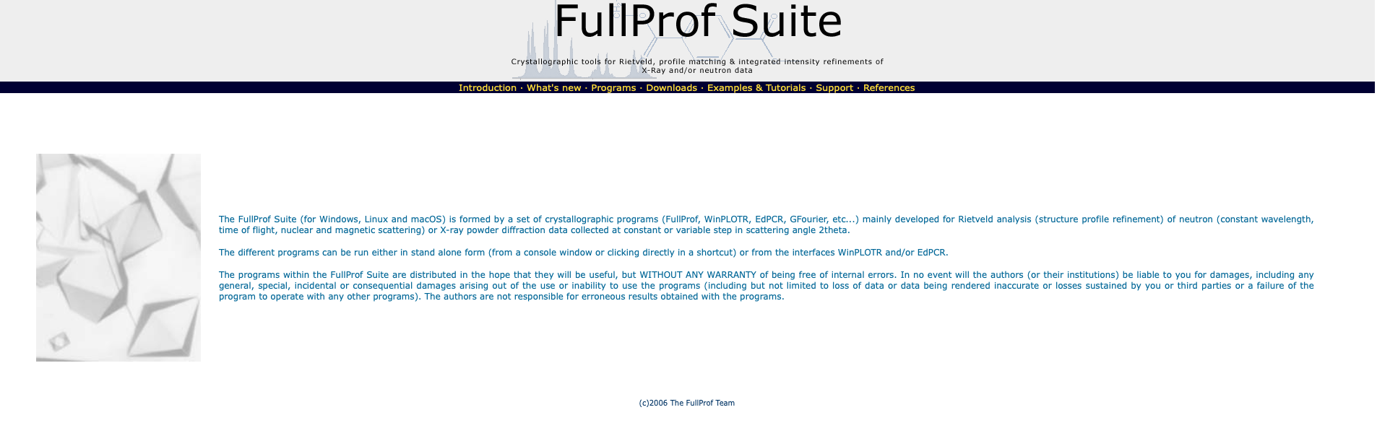

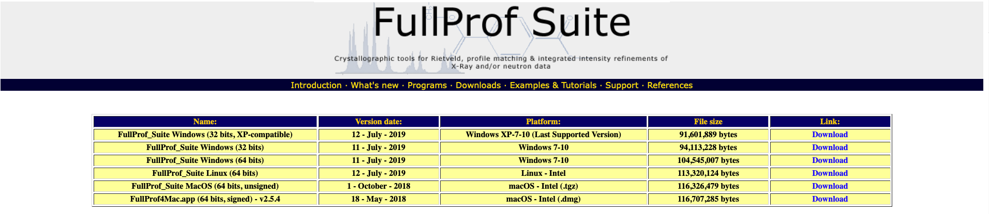
Installation of FullProf
(1) Install Fullprof Suite
(2) Download Exercises -dat

Slide 47
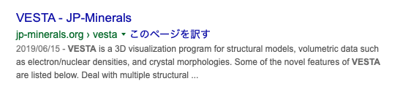
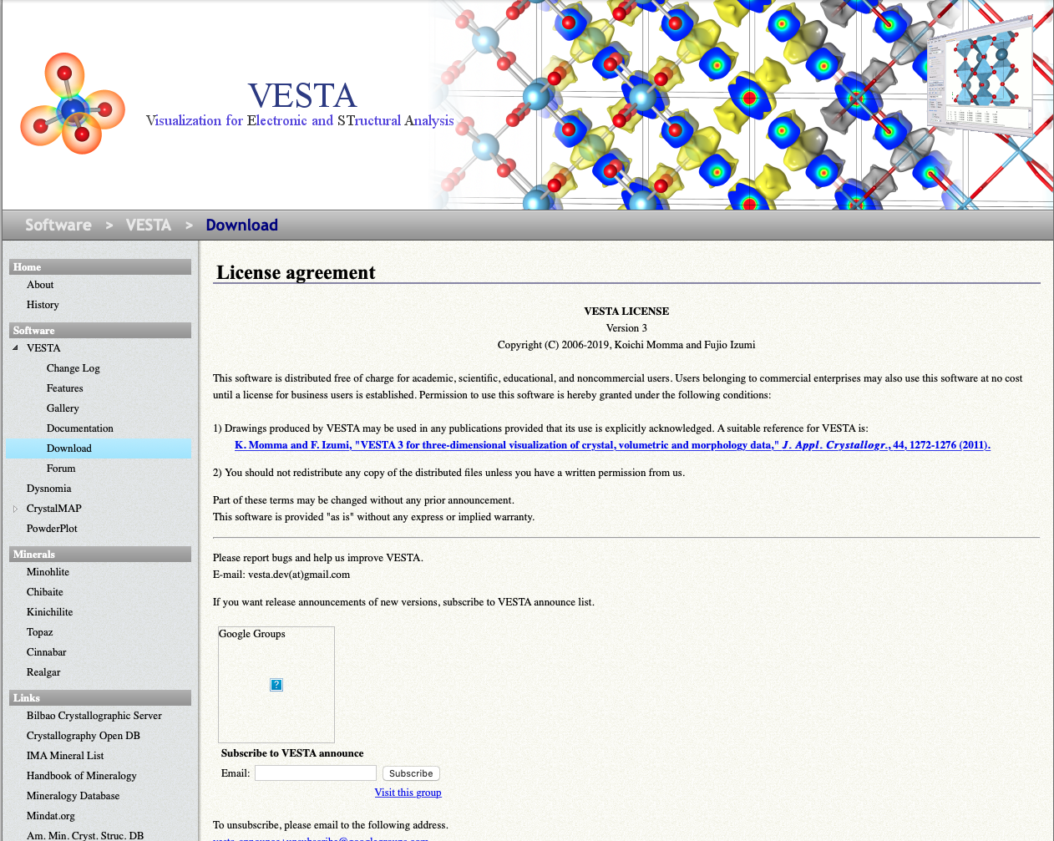
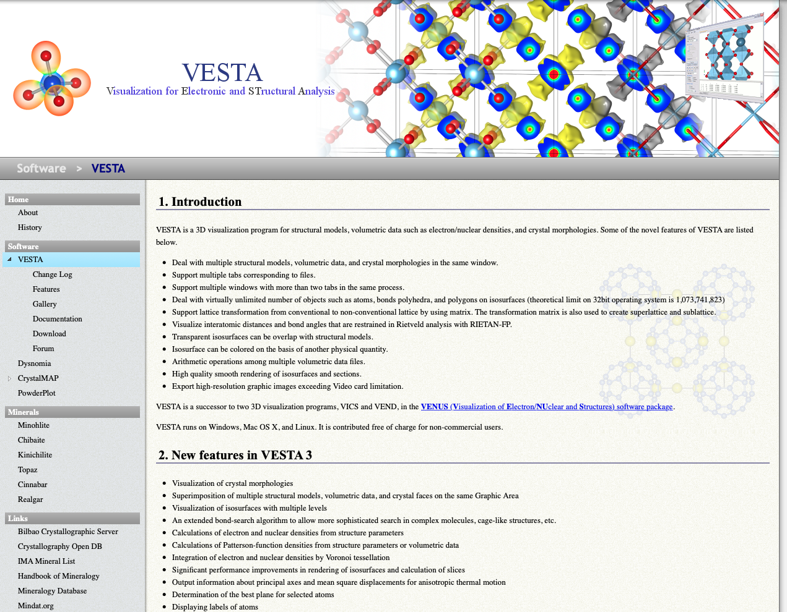
Installation of VESTA

Slide 48

Recommendation: Editor
Notepad++ : MS
TextWrangler: Mac

Slide 49
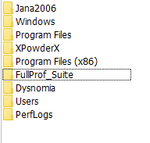
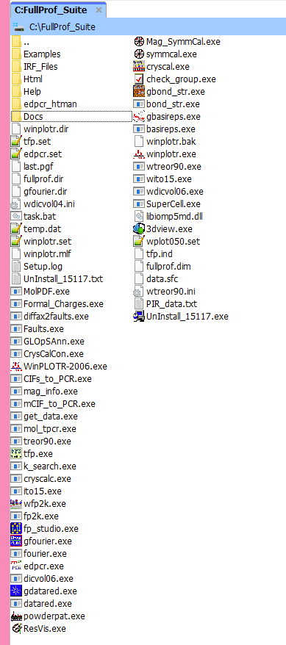
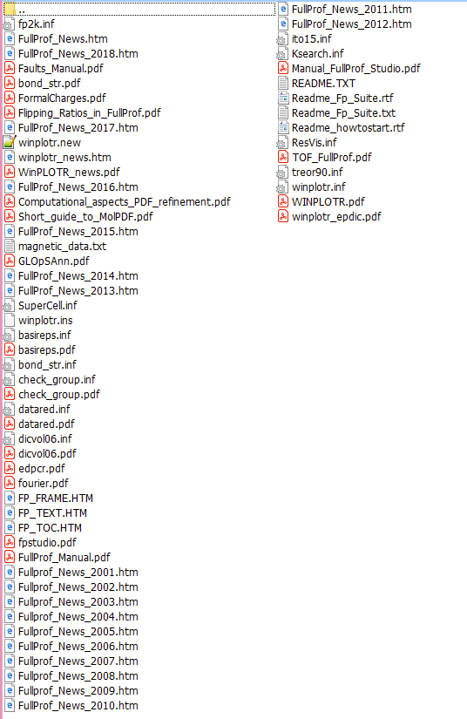
FullProf package

Slide 50

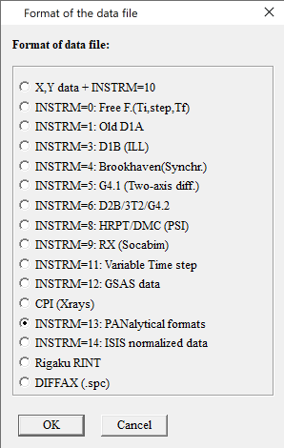
How to open the diffraction pattern (Fullprof)
Many European neutron facility formats are covered!

Slide 51
Step by Step data analysis
Identification of phases
Indexing the Bragg peaks
Space group determination
Structure solution
Structure refinement

Slide 52
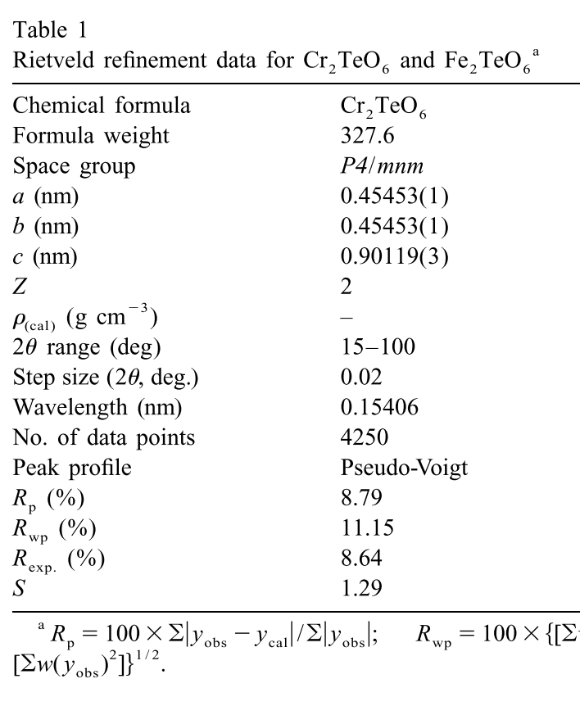
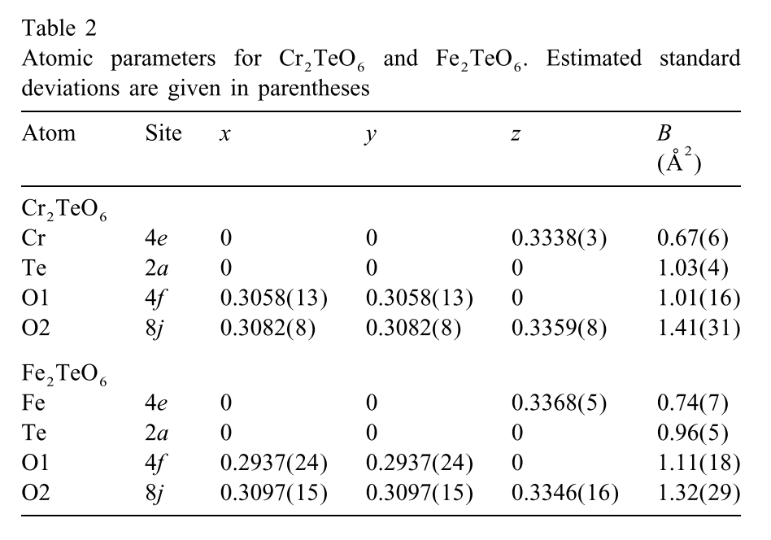
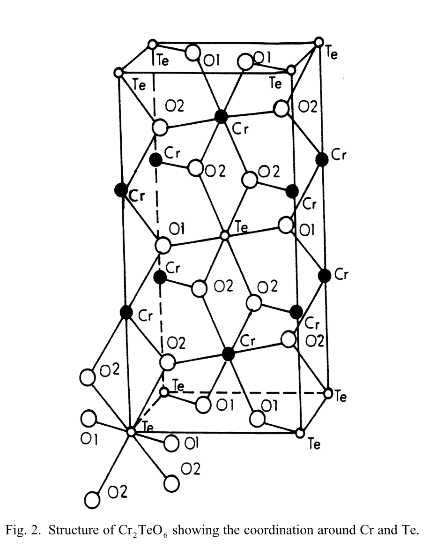
Identification of phases
Identification of know phases
  You know what it is!
  Start with the known structural information!
K. Krishnan et al., J. Alloys Compd. 316, 264–268 (2001).

Slide 53
Identification of phases
Identification of know phases
  You know what it is!
  Start with the known structural information!
  Novel phase?
  Try Powder pattern-matching by searching the data base.
  It might be known!
  Search the ICSD structural database based on information you have!

Slide 54
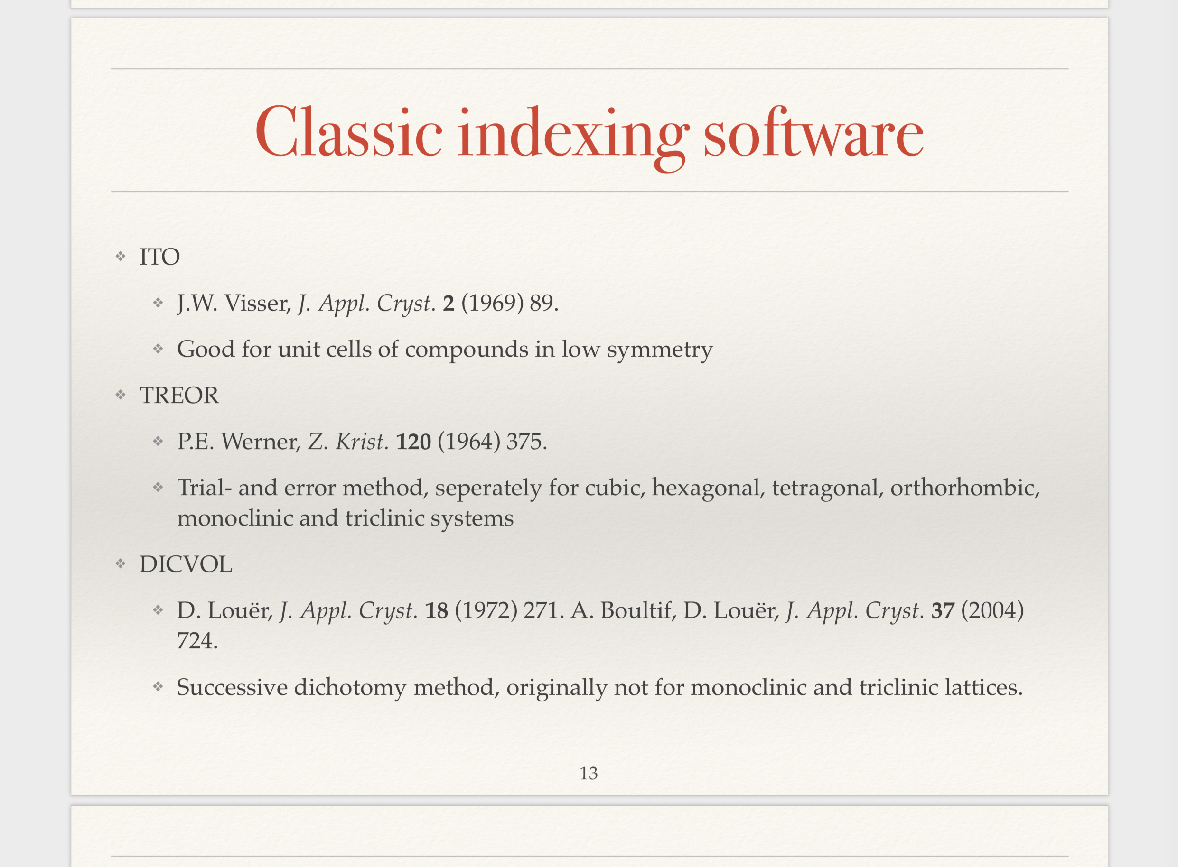
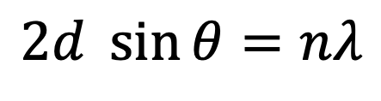
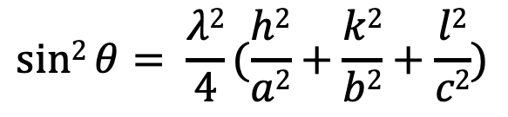
2.Indexing the Bragg peaks
$$2d \sin{θ}=nλ$$
Software (in Fullprof suite)
ITO [J.W.Visser, J.Appl, Cryst.2 (1969) 89.]
TREOR [P.E.Werner, Z. Krist. 120 (1964) 375.]
DICVOL [D.Louer, J. Appl. Cryst. 18 (1972) 271. A. Boultif,D.Louer, J.Appl. Cryst. 37 (2004)]
Orthorhombic System:
$$sin2{θ= \frac{λ2}{4}(\frac{h2}{a2}+\frac{k2}{b2}+\frac{l2}{c2})}$$
2θ positions of reflections
→ Lattice parameters

Slide 55
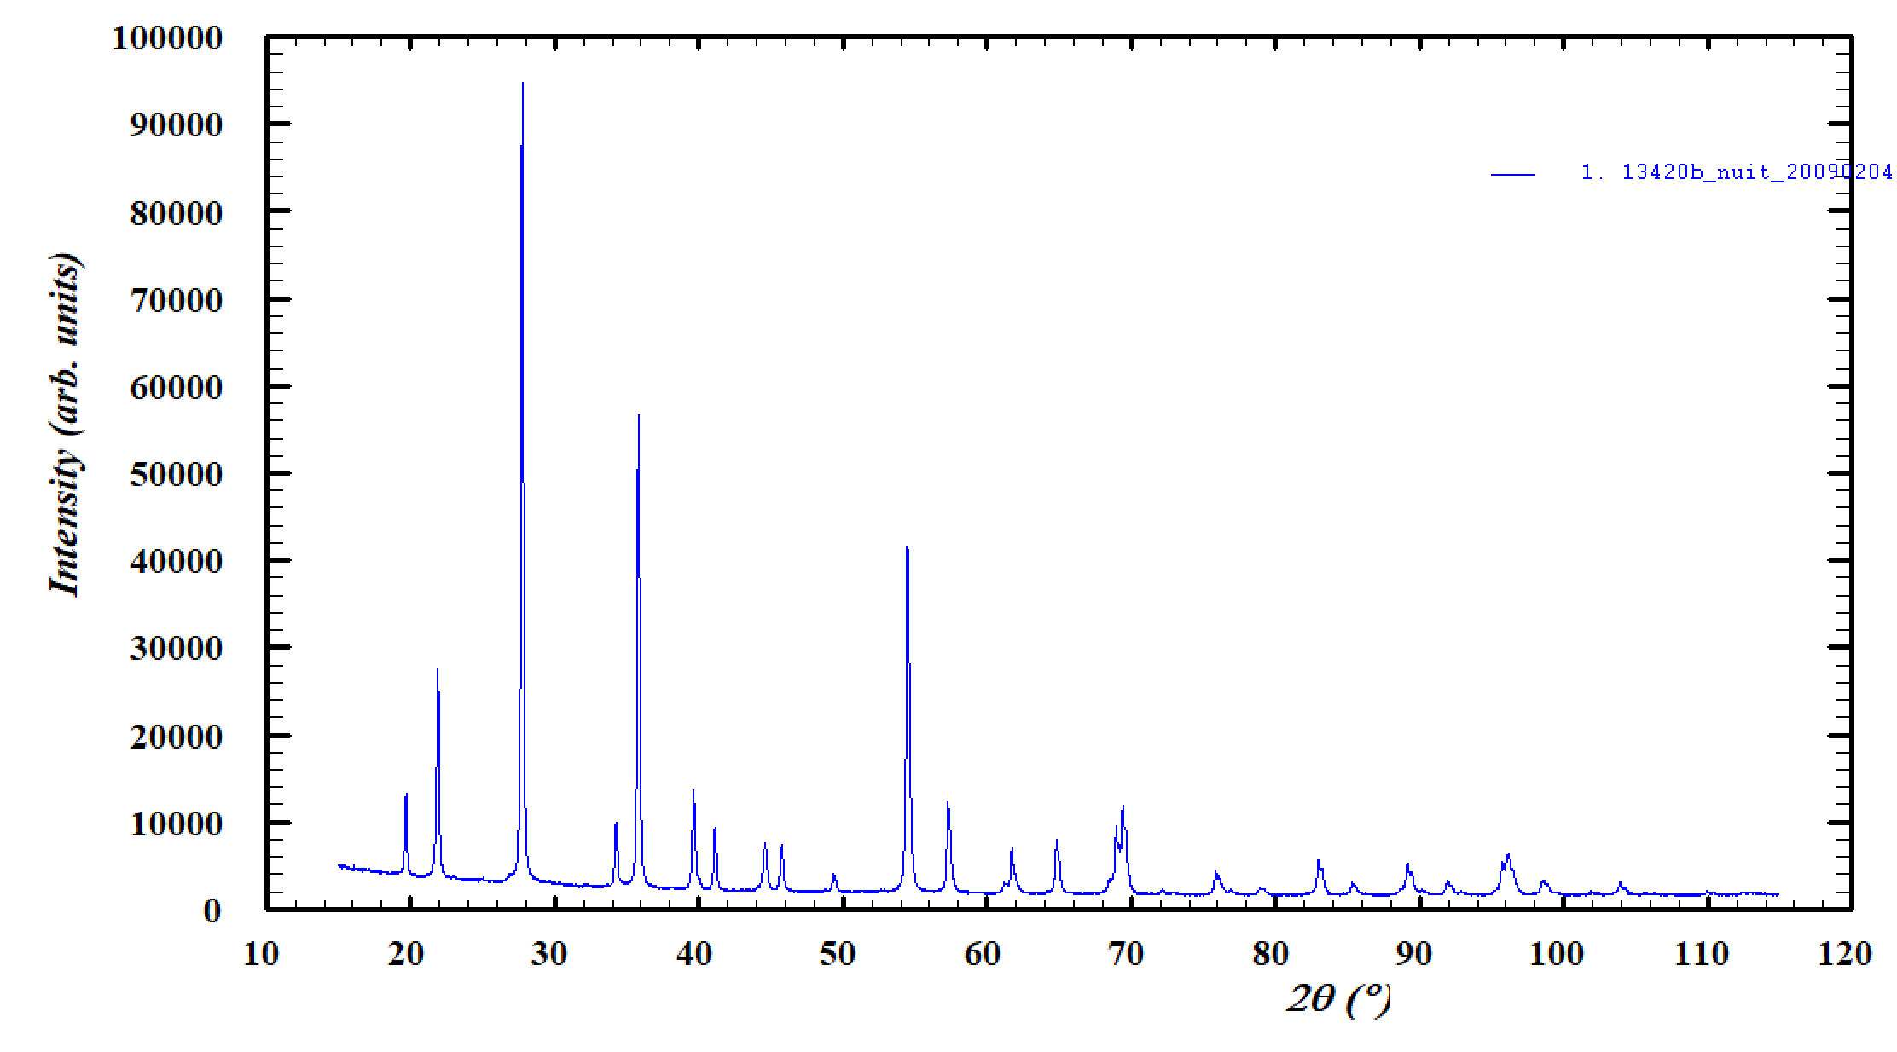
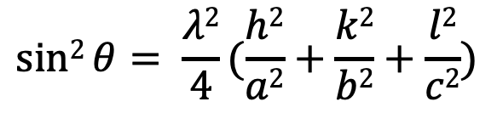
2.Indexing the Bragg peaks
$$sin2{θ= \frac{λ2}{4}(\frac{h2}{a2}+\frac{k2}{b2}+\frac{l2}{c2})}$$
Give the position of Bragg peak position
Give possible crystal system
Give wavelength
RUN!

Slide 56
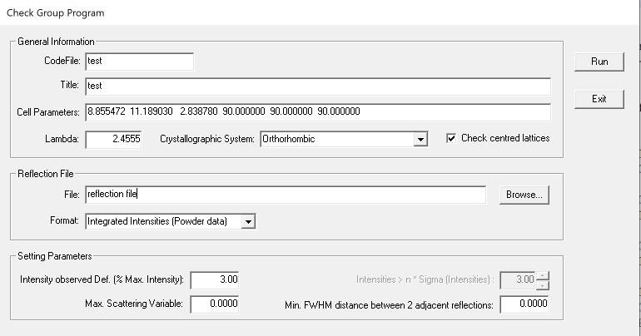
3.Space group determination
Checking the possible space group based on the extension rule!
Try and error refinement using different combination of SG and cell parameter

Slide 57
Le Bail Fit
Le Bail fit (Profile matching)
Bragg positions (Indexation)
No atomic position information
But SG and lattice constant + Peak shape parameters
Software tries to fit intensity as nice as possible. (Scale is a free parameter.)
No structure information
Scale factor: Fixed
Number of atom: 0
2

Slide 58
Rietveld refinement
Rietveld refinement
Analysis of Intensities
Structural information
  Atomic form factor
  Position of atoms
  Thermal displacement parameters
  Magnetic moments
This is the standard method to treat powder diffraction data for structure refinement.
Introduced by Hugo Rietveld in 1967, 1969
[H.M. Rietveld, Act Cryst. 22 (1967) 151]
[H.M. Rietveld, J.App.Cryst. 2 (1969) 65]
0

Slide 59

The calculated profile
$$y_{cal}=s\sum_{\{h\}}{LK\left|FK\right|2 φ\left({2θ}_{i}−{2θ}_{K}\right)PKA+y_{i}}$$

Slide 60
The calculated profile
$$y_{cal}=s\sum_{\{h\}}{LK\left|FK\right|2 φ\left({2θ}_{i}−{2θ}_{K}\right)PKA+y_{i}}$$
Calculated
intensity

Slide 61
The calculated profile
$$y_{cal}=s\sum_{\{h\}}{LK\left|FK\right|2 φ\left({2θ}_{i}−{2θ}_{K}\right)PKA+y_{i}}$$
Calculated
intensity
Scale factor

Slide 62
The calculated profile
Sum over all Bragg peaks
$$y_{cal}=s\sum_{\{h\}}{LK\left|FK\right|2 φ\left({2θ}_{i}−{2θ}_{K}\right)PKA+y_{i}}$$
Calculated
intensity
Scale factor

Slide 63


The calculated profile
Sum over all Bragg peaks
$$y_{cal}=s\sum_{\{h\}}{LK\left|FK\right|2 φ\left({2θ}_{i}−{2θ}_{K}\right)PKA+y_{i}}$$
Calculated
intensity
Scale factor
Lorentz factor
Monochromator polarization correction
$$LK= \frac{1−K+K\cos{22θ∙\cos{2θ}}}{2sin{2θ}\cos{θ}}$$
$K=0$For neutron

Slide 64
The calculated profile
Sum over all Bragg peaks
Structure factor
$$y_{cal}=s\sum_{\{h\}}{LK\left|FK\right|2 φ\left({2θ}_{i}−{2θ}_{K}\right)PKA+y_{i}}$$
Calculated
intensity
Scale factor
Lorentz factor

Slide 65
The calculated profile
Sum over all Bragg peaks
Structure factor
$$y_{cal}=s\sum_{\{h\}}{LK\left|FK\right|2 φ\left({2θ}_{i}−{2θ}_{K}\right)PKA+y_{i}}$$
Calculated
intensity
Scale factor
Profile parameter
Lorentz factor

Slide 66
The calculated profile
Sum over all Bragg peaks
Structure factor
Preferred orientation
$$y_{cal}=s\sum_{\{h\}}{LK\left|FK\right|2 φ\left({2θ}_{i}−{2θ}_{K}\right)PKA+y_{i}}$$
Calculated
intensity
Scale factor
Profile parameter
Lorentz factor

Slide 67
The calculated profile
Sum over all Bragg peaks
Structure factor
Preferred orientation
$$y_{cal}=s\sum_{\{h\}}{LK\left|FK\right|2 φ\left({2θ}_{i}−{2θ}_{K}\right)PKA+y_{i}}$$
Calculated
intensity
Scale factor
Profile parameter
Absorption
Lorentz factor

Slide 68
The calculated profile
Sum over all Bragg peaks
Structure factor
Preferred orientation
Background
$$y_{cal}=s\sum_{\{h\}}{LK\left|FK\right|2 φ\left({2θ}_{i}−{2θ}_{K}\right)PKA+y_{i}}$$
Calculated
intensity
Scale factor
Profile parameter
Absorption
Lorentz factor

Slide 69

The calculated profile
Sum over all Bragg peaks
Structure factor
Preferred orientation
Background
$$y_{cal}=s\sum_{\{h\}}{LK\left|FK\right|2 φ\left({2θ}_{i}−{2θ}_{K}\right)PKA+y_{i}}$$
Calculated
intensity
Scale factor
Profile parameter
Absorption
Lorentz factor
$R_{wp}=\sqrt{\frac{\sum_{i}{w_{i}\left(y_{i}^{obs} −y_{i}^{cal}\right)2}}{\sum_{i}{w_{i}\left(y_{i}^{obs}\right)2}}}$
The parameters in y_{calc} undergo a least-square refinement to minimize R_{wp}

Slide 70




Structure factor with structural parameters
$$y_{cal}=s\sum_{\{h\}}{LK\left|FK\right|2 φ\left({2θ}_{i}−{2θ}_{K}\right)PKA+y_{i}}$$
The structure factor
$$Fhkl= \sum_{n=0}^{N}{bn∙e^{2πi(hx+ky+lz)}}$$
$$b= b_{i}exp⁡(−Bsin2{θ}/λ)$$
`
u² :the root mean square displacement of the atom from its average position
$$B=8π^{2}u^{2} (Å)$$
B-factor/ Thermal displacement parameter

Slide 71


Structure factor with structural parameters
$$y_{cal}=s\sum_{\{h\}}{LK\left|FK\right|2 φ\left({2θ}_{i}−{2θ}_{K}\right)PKA+y_{i}}$$
The profile function
Gaussian: $φ\left({2θ}_{i}−{2θ}_{K}\right)gauss= \frac{2\sqrt{ln2}}{H\sqrt{π}}e^{\frac{−4ln2}{H^{2}}\left({2θ}_{i}−{2θ}_{K}\right)2}$
Lorentzian: $φ\left({2θ}_{i}−{2θ}_{K}\right)lortenz= \frac{2\sqrt{ln2}}{H\sqrt{π}}\frac{1}{1+\frac{4}{H2}\left({2θ}_{i}−{2θ}_{K}\right)2}$
$H_{lortenz}=\sqrt{Utan2{θ}+V\tan{θ}+W}$
Gaussian
Lorentzian

Slide 72

Structure factor with structural parameters
$$y_{cal}=s\sum_{\{h\}}{LK\left|FK\right|2 φ\left({2θ}_{i}−{2θ}_{K}\right)PKA+y_{i}}$$
The profile function
pseudo-Voigt: $φ\left({2θ}_{i}−{2θ}_{K}\right)pseudoVoigt=η∙φlortenz+(1−η)∙φgauss$
Fullprof: Npr = 5
The Thompson-Cox-Hastings pseudo-Voigt
Instrumental parameters (Sample independent)
$H_{gauss}=Utan2{θ}+V\tan{θ}+W+ \frac{I_{G}}{\cos{2θ}}$
Fullprof: Npr = 7
$H_{lorentz}=X\tan{θ}+ \frac{Y}{\cos{θ}}$
Size-dependent
Strain-dependent

Slide 73

FullProf: Powder diffraction analysis
Data file
.PCR file: Input file (Fullprof reads lines)
Input
Output
Main control codes line for the phase
Experimental set-up
Refinement parameters
(option) Bond-Valence or distance and angles calculations
Excluded regions
Space group
Experimental set-up 2
Number of refined parameter
Atomic
parameter
Background
Scale factor
Fix : 0
Vary :1
Profile parameter
Cell parameter

Slide 74

Let’s try together
1 Mg Mg1 0.00000 0.00000 0.00000 1.000 1.000 8a -43m
2 Al Al1 0.62500 0.62500 0.62500 1.000 1.000 16d .-3m
3 O O1 0.38730 0.38730 0.38730 1.000 1.000 32e .3m
Neutron powder diffraction
T = 300K
3T2 (LLB) (Data format: INS=1)
λ = 1.227 Å
Profile parameters function NPR=7
  MgAl₂O₄
Space Group: F d -3 m
Atomic position
Tetrahedral A-positions (Mg,Al) 8a (1/8,1/8,1/8)
Octahedral B-positions (Mg,Al) 16d (1/2,1/2,1/2)
Oxygen positions (O) 32e (x,x,x) x = 0.26
Unit cell : a = 8 Å
MgO impurity
Space Group: F m -3 m
Atomic position
Mg positions (Mg) 4a (0,0,0)
Oxygen positions (O) 4b (1/2, 1/2, 1/2)
Unit cell : a = 4.22 Å
  Data from Fullprof website

Slide 75

Steps of the refinement
Refinement in several steps
  Scale factor
  Background
  Lattice parameters and zero shift
  Atomic positions
  Thermal parameter
  Occupational parameters (if necessary )
  Profile parameters
You can refine structure (these parameters) using diffraction data!

Slide 76
FullProf files
Data file
.PCR file: Input file
.OUT file
.SUM file
.CIF file - VESTA
.HKL file

Slide 77
Difficulties
More parameters More difficult!
High background
Peak broadening
  Anisotropic
  Asymmetric shape
Too large or too small crystallites
Absorption
More than single phase (impurity)
Low symmetry..!

Slide 78

Now you try!: LaMnO₃
Crystal structure determination of LaMnO₃: 300K, 573K, 798K
Neutron powder diffraction
T = 300K, 573K and 798K
3T2 (LLB) (Data format: INS=6)
λ = 1.227 Å
Profile parameters function NPR=7
Space Group: P b n m
Atomic position
La 4c (0, 0.05, 0.25)
Mn 4a (1/2 0 0)
O1 4c (0, 0.49, 0.25)
O2 8d (0.7, 0.3, 0.04)
Unit cell : a = 5.5 Å, b = 5.7 Å, c = 7.7 Å
B_{iso}: start from 1.00
Zero: 0.00
Refine profile parameter: Y only start from 0.00
A signature of phase transition above 798K, but this time we will fit whole temperature pattern using same structure (Pbnm).
  Data from Fullprof website
Mission (1) Find unit cell (using DICVOL)
(2) Le Bail Fit
(3) Rietveld refinement starting from structure above
(4) Plot unit cell parameters, bond distances and thermal displacement parameters
(5) Visualize the refined structure using VESTA

